Slide 1


Business Intelligence Analyst
Ahmed Farouk Abdel-Sattar
IBM Analytics Consultant
IBM Egypt
afarouk@eg.ibm.com
Phone: 01001083054
Ahmed Abdel-Baky
Software Engineer – Business Analytics
IBM Egypt
abaky@eg.ibm.com
Phone: 01066876260 / 01110887370

Slide 2
Agenda
Introduction
IBM Skills Academy Program
Business Analytics & Business Intelligence
B6058 IBM Cognos Analytics Author Reports Fundamentals (v11.0)
B6059 IBM Cognos Analytics Author Reports Advanced (v11.0)
B6098 IBM Cognos Analytics - Author Active Reports (v11.0)

Slide 3
IBM Skills Academy ibm.biz/ibmskillsacademy
Program Benefits
Available Badges
Explorer Award
Mastery Award
Instructor Award
Author Award
Students
Teachers
Universities
Professionals
Notes:
The instructor should open “IBM Africa Skills Academy Program - High-Level Overview.pptx” here.
https://www.ibm.com/developerworks/community/files/app/file/8e411ebd-9047-4233-8d1c-dc7a2eebd77c

Slide 4
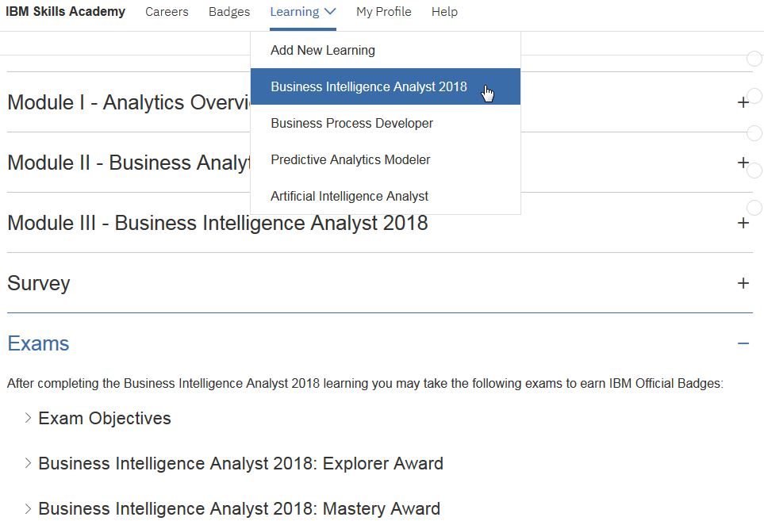
Before exam 1. login to the portal: www.ibm.biz/ibmskillsacademy and make sure you are registered and can see this 2. Fill the survey
60 questions 90 minutes passing score: 60%
Notes:
Corresponding professional exam: IBM Cognos Analytics Author V11
C2090-621
http://www-03.ibm.com/certify/exam.html?id=C2090-621

Slide 5
Introduction to Business Analytics, and Business Intelligence

Slide 6
What is Analytics?
How to make it happen?
Prescriptive Analytics
What will happen?
Predictive Analytics
Why did it happen?
Diagnostic Analytics
Value
What happened?
Information Optimization
Descriptive Analytics
Analytics is using analysis capabilities to address these questions
Difficulty
Notes:
References:
1) From predictive to prescriptive: Transforming business decisions with analytics
https://www.ibm.com/blogs/analytics-zone/from-predictive-to-prescriptive-transforming-business-decisions-with-analytics
2) Introduction to Big Data & Analytics
http://dlapp03.atlanta.ibm.com/hr/global/quickviews/Introduc.nsf/Content/85257B8F%3A0063E78A

Slide 7
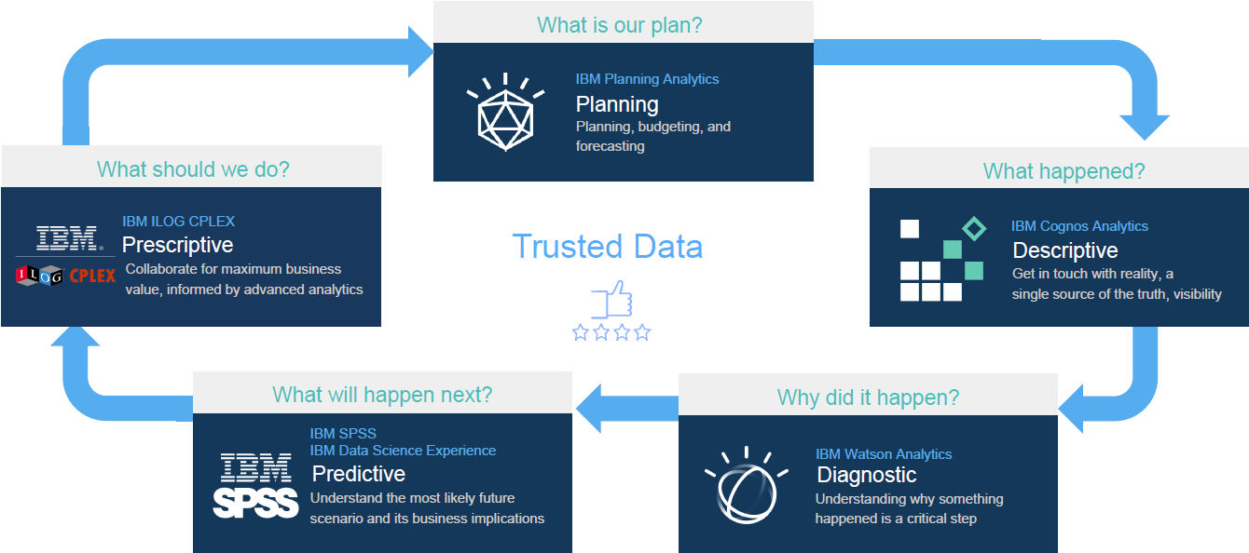
IBM Analytics portfolio
Analytics is using analysis capabilities to address these questions

Slide 8

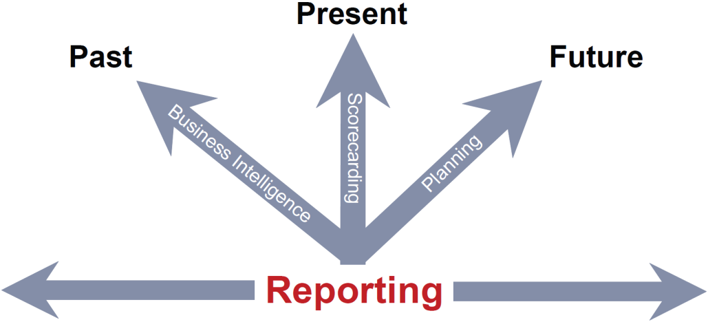
Analytics for Performance Management
Data
Accurate
In time
Complete
Decision(s)
All levels
Performance
Information
Business Intelligence: turn data into useful information that you can take decisions on; to improve performance
Areas to improve?
Acquire, grow, and retain customers
Minimize/manage risk
Optimize operations and reduce fraud
Transform financial processes
Notes:
References:
Cognos BI Professional Workshop (Student Handguide) page 89
http://public.dhe.ibm.com/partnerworld/pub/certify/cognos_8_bi_professional_workshop_student_handguide.pdf
Areas to improve:
Introduction to Big Data & Analytics > Value
http://dlapp03.atlanta.ibm.com/hr/global/quickviews/Introduc.nsf/Content/85257B8F%3A0063FF17

Slide 9
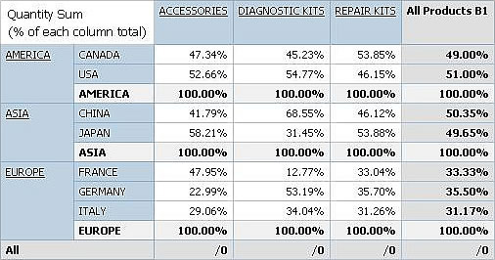
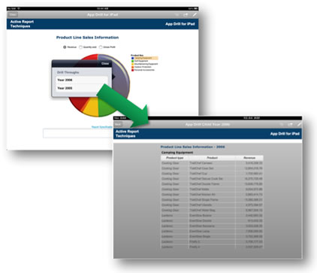
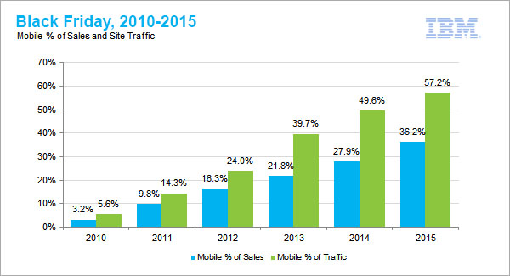
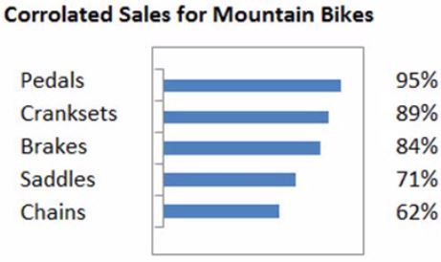
Business Intelligence Functions
Aggregation & Drilling
Trends
Correlations (enable Data Mining)

Slide 10

Business Analytics - Turning Data Into Insight
Notes:
Another video:
Business Analytics: Data Trends Let Businesses Spot New Opportunities
https://youtu.be/HbHTvqZE3D8

Slide 11

Questions that BI can answer
How effective are our training programs? Does employee behavior change afterwards?
How did the replacement of this raw material change my profit?
What are our top three most profitable customer segments?
Who are our potential customers?
If we are looking at our highest paying customers, are the really our most profitable? Or we are spending too much to make them happy?
What are our best products? Are there any upselling or cross-selling opportunities we can use?
Where are we doing well? And what are the areas that need improvement?
Notes:
References:
What kind of questions can BI answer? http://www.simplebi.com/faq-friday-what-kind-of-questions-can-bi-answer
25 Questions You Didn’t Know Business Intelligence Could Answer for Your Business http://customerthink.com/25-questions-you-didnt-know-business-intelligence-could-answer-for-your-business
7 big questions that BI can help you answer https://www.mrc-productivity.com/blog/2015/01/7-big-questions-that-bi-can-help-you-answer

Slide 12
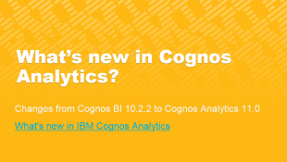

IBM Cognos Analytics Author Reports Fundamentals (v11.0)
B6058

Slide 13
Table of Contents – B6058
A) Introduction to IBM Cognos Analytics
Introduction to IBM Cognos Analytics - Reporting
Create List Reports
Focus Reports Using Filters
Create Crosstab Reports
Present Data Graphically
Focus Reports Using Prompts
Extend Reports Using Calculations
Use Additional Report Building Techniques
Customize Reports with Conditional Formatting
Drill-Through Definitions
Enhance Report Layout

Slide 14
A Introduction to IBM Cognos Analytics
TOC

Slide 15
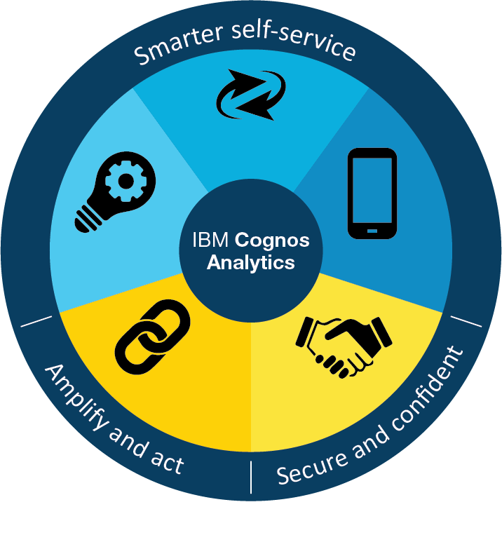
What is IBM Cognos Analytics? BI redefined
Complete web-based BI solution
Consistent user experience
Consistent: desktop/mobile, connected/disconnected
On-demand toolbars and menus
Intuitive and interactive UI
Smarter self-service (guided, built-in intelligence)
Consumers (static/interactive reports)
Creators
Dashboards and infographics
Data Modules and ad-hoc reports
Power users
Data model
Professional reports
Single scalable environment for departmental and enterprise reporting
Smarter self- service
Agility
Intelligence
Secure and confident
Mobility
Amplify and act
Connected
Trusted

Slide 16

Common Workflow for BI
Business presentation view of data sources
Author
Reporting
Model
Package
Framework Manager
Transformer
Dashboard
Dynamic Cube Designer
Relational
Files
Cubes
Other
Notes:
Delivery process of Business Analytics projects:
Business Analytics Solution Implementation Method (BASIM): http://public.dhe.ibm.com/common/ssi/ecm/yt/en/ytd03136usen/YTD03136USEN.PDF
Download: https://www14.software.ibm.com/webapp/iwm/web/pick.do?source=swerpba-basimext

Slide 17
Model data with IBM Cognos Analytics
Metadata model provides a business presentation view of data sources
Use the model to analyze and report on their data sources
In Cognos Analytics
Easy access to data (enterprise/personal)
Easily combine Data Modules
Intent-driven modeling
Accelerated authoring and testing
Reporting Layer
IBM Cognos Metadata Model
Cubes
Relational
Files
Other

Slide 18
IBM Cognos Analytics components
Web
IBM Cognos Analytics portal
Reporting
Dashboards
Stories
Cognos Viewer
Administration
Consumer, Author, Administrator
Personal files
Cognos Analytics
Data Modules
Event Studio
PowerPlay Studio
Framework Manager
Dynamic Cube Designer
Transformer
Modeler
Data Administrator
Dimensional
Relational
Files
IBM Cognos
Content
Other

Slide 19
IBM Cognos Analytics Architecture
Interfaces
Web Server (Gateways)
ODBC
Oracle
SQL Server
Web-based (Cognos Analytics portal)
Windows-based (Framework Manager, Dynamic Cube Designer, Transformer)
SDK
Tier 1: Web server
Content Manager + Cognos services + Dispatchers
Tier 2: Applications
Tier 3: Data
JDBC
…
Content Store
DB2
Notes:
Dispatcher: does routing for Cognos services (load balancing & failover)
Gateway: allows only dedicated controlled and secured communication paths between dispatchers and external world
Reference: http://www.ibm.com/developerworks/data/library/cognos/infrastructure/cognos_specific/page510.html
Cognos Analytics services include:
Presentation Service
Report Service
Batch Report Service
Job Service
Monitoring Service
Log Service
Content Manager Service
Metrics Manager Service
Data Integration Service
Source:
https://www.ibm.com/support/knowledgecenter/SSEP7J_11.0.0/com.ibm.swg.ba.cognos.ug_cra.doc/c_reportnet_components.html

Slide 20
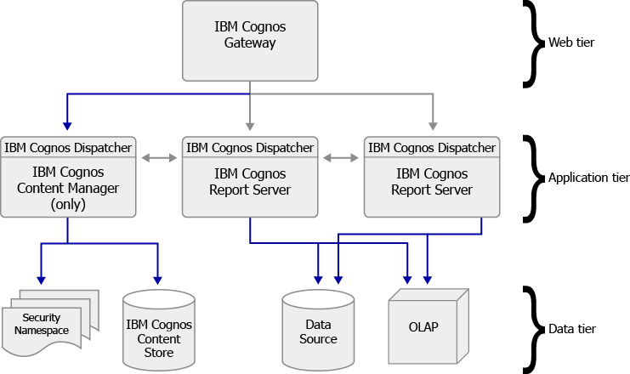
Example IBM Cognos Deployment
Notes:
Source:
http://doc.arcgis.com/en/maps-for-cognos/install-windows/ibm-cognos-architecture.htm

Slide 21
IBM Cognos Analytics Security
Cognos Analytics authentication is based on the use of 3rd party authentication providers
Authentication: who are you?
Authorization: what can you see?
Administration: manage access
Predefined groups & roles:
System Administrators
Authors
Query Users & Analysis Users
Consumers
Readers

Slide 22
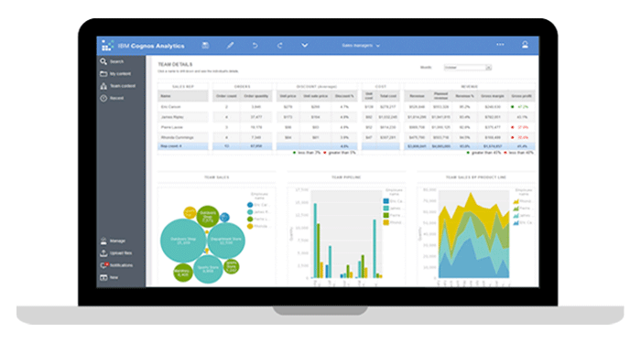
Package/Data Source Relationship
What happens at runtime?
Report / Dashboard
Data Source(s)
Query Database
Package(s) (model)
Connection
Signon

Slide 23
Data Modules
Model data from different data sources
uploaded & corporate data
Guided/intent-driven modeling (intent panel)
Generate models based on keywords
Try It feature
Test the model in reporting environment
Live data mode (default) or snapshots
to improve query performance

Slide 24
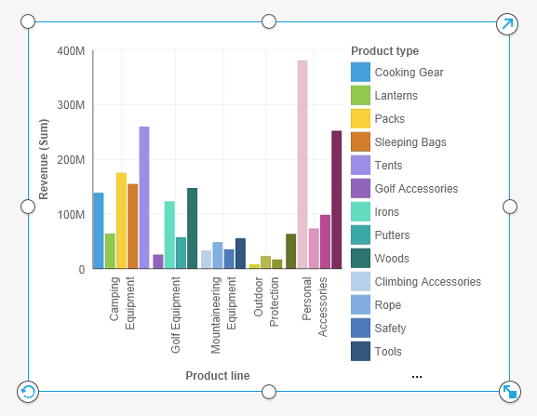
Demo 1: Explore IBM Cognos Analytics
Search for “sales growth” & save the search
Open Team content > Reports > Standard reports > Sales growth year over year
Upload a personal file and create a dashboard using the uploaded file
Create a report using Reporting
Examine the model in Framework Manager C:\Program Files\IBM\cognos\samples\ webcontent\samples\models\ great_outdoors_warehouse_dq
Examine the underlying database

Slide 25
OLAP Data Structures - Cube
Fax
Telephone
Camping Equipment
Members
Mail
E-Mail
Golf Equipment
Web
Cell
Order Methods
Outdoor Protection
Mountaineering Equipment
Dimension
Personal Accessories
Products
Jan
Feb
...
Q1
Q2
...
2005
2006
...
2005
Q1
Q2
Q3
Q4
Hierarchy/Levels
Time
Notes:
From course:
B5A52 - IBM Cognos Framework Manager Design Metadata Models (v10.2.2)

Slide 26
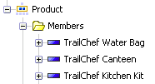
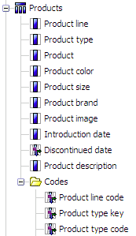
Entities in Different Data Structures
Extend dimensional capabilities to relational data sources
Relational
OLAP/DMR
Product
TrailChef Water Bag
TrailChef Canteen
TrailChef Kitchen Kit
Members
Product
Aloe Relief
Astro Pilot
Auto Pilot
Values

Slide 27
Relational Models: Operational vs. Reporting
Requirement: Show all customer types that bought from a product line.
Relational = Operational
Dimensional = Reporting
Customer Type
Sales Area
Product Line
Sales Rep
1..1
1..1
1..1
1..n
1..n
1..n
1..1
Customer
Sales Rep
Product Type
0..n
Customer
Order Fact
Product
1..1
1..1
0..n
0..n
1..1
1..1
1..1
1..n
1..n
0..n
1..1
Order Header
Product
Date
1..n
1..1
1..1
1..n
Order Detail
1..n

Slide 28
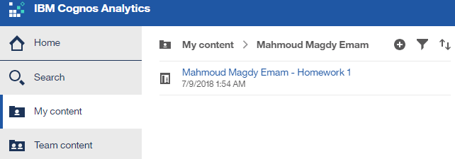
Delivering the Homework
Materials: ibm.biz/ibmPPTs
Use IBM Cognos Analytics on the cloud
ibm.biz/cognosAnalytics Namespace: IBMDemo Username: Administrator Password: IBMDem0s
Create a folder for yourself under My content
Save your homework there
Send to the instructor and/or assistant the path to your folder
Notes:
This URL is case-sensitive.
Another way for sending the homework:
Access Cognos Analytics on IBM’s public cloud at: http://ibm.biz/catrial
Login with your IBM ID.
Copy a report to the clipboard in Internet Explorer http://www.ibm.com/support/knowledgecenter/en/SSEP7J_11.0.0/com.ibm.swg.ba.cognos.ug_cr_rptstd.doc/t_copy_report_clipboard_ie.html Copy a report to the clipboard in Firefox http://www.ibm.com/support/knowledgecenter/en/SSEP7J_11.0.0/com.ibm.swg.ba.cognos.ug_cr_rptstd.doc/t_id_copy_report_74copyareporttotheclipboardinfirefox.html
Save the copied report code to an XML file
Send the XML file in a mail to the instructor and/or assistant

Slide 29
Browser Configuration
Control Panel > Internet Options
Security > Internet > Custom Level
Miscellaneous:
Include local directory path when uploading files to a server: Enable
Scripting:
Allow programmatic clipboard access: Enable
Enable XSS filter: Disable
Privacy > Popup-up Blocker > uncheck Turn on Pop-up Blocker
IE11 (for Administration only): Tools > Compatibility View Settings > Add
Disable Pop-up Blocker
Chrome:
chrome://settings/content
Pop-ups > Allow all sites to show popups
Firefox

Slide 30
1 Introduction to IBM Cognos Analytics - Reporting
TOC

Slide 31
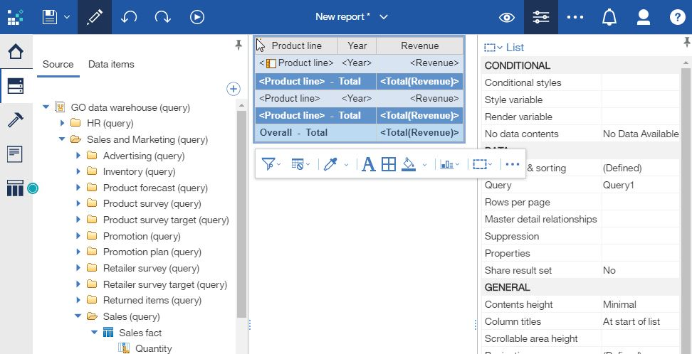
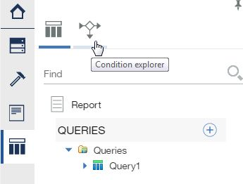
IBM Cognos Analytics - Reporting
Web-based report authoring tool
Data
Application Bar
Properties
Toolbox
Pages
Queries
Query explorer
Condition explorer
On-demand Toolbar
Work area
Side Panel
Content pane

Slide 32
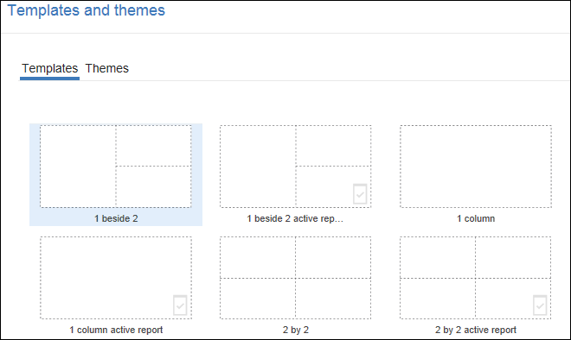
Authoring Templates
Specify structure/layout of the report

Slide 33
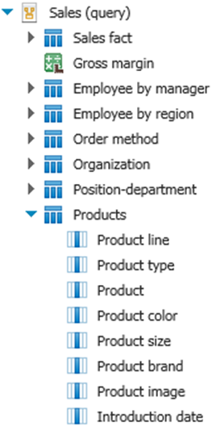
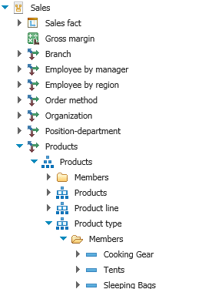
Relational vs. Dimensional/DMR Sources
GO Data Warehouse (query)
GO Data Warehouse (analysis)
Namespace
Facts / Measures
Query Subject
Dimension
Hierarchy
Query Item
Level
Members

Slide 34
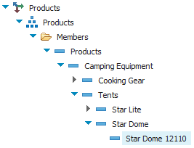
Demo 2: Create a Report from DMR Data Source
Dimensionally-Modelled Relational (DMR) models extend dimensional capabilities to relational data sources
Allow drill-down and drill-up in hierarchies
Notes:
TODO: dynamic drilling down and up

Slide 35
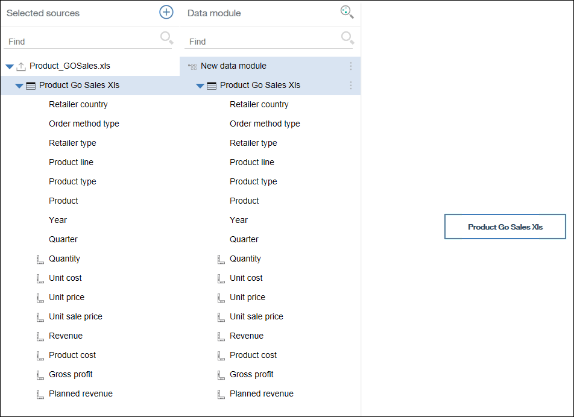
Demo 3: Personal data sources and data modules
Upload data files
Create data modules
Notes:
Page 46 of B6058_Course_Guide.pdf

Slide 36
2 Create List Reports
TOC

Slide 37
Demo 1: Enhance a List Report
Undo / Redo
Automatic group and summary behavior for lists
Grouping, group span
List page header and Overall header
List column body, List column title, List Column

Slide 38
Demo 2: Data Aggregation
Detail Aggregation: aggregates data at the lowest level of detail
Applied by data modeler at the model
Applies only when Auto Group and Summary is Yes
Automatic: based on data type (Integer: Total, …etc)
Summarize: same as model
Summary Aggregation
Applied by report author to grouped items
Provides higher level aggregation

Slide 39
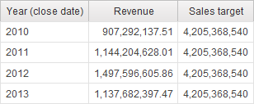
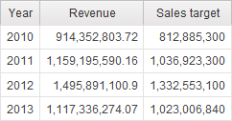
Demo 3: Create Multi-Fact Query in a List
Use shared (conformed) dimensions to create multi-fact queries
now depends on year
related
related
unrelated
related

Slide 40
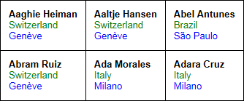
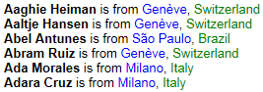
Add Repeated Information to Reports
Repeater table
Repeat items in a table structure
Example: 3 columns and 2 rows
Repeater
Duplicate items across a single row without a particular structure
Example: Each record in a block

Slide 41
3 Focus Reports Using Filters
TOC

Slide 42
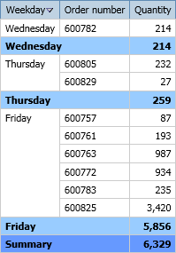
Detail & Summary Records
Detail record
(1 row in from database)
Summary records
(calculated by the query)
Notes:
Tool: Query Studio
Filters: City: London, Month: October 2010, Product line: Personal Accessories
Sort order: Weekday DESC

Slide 43
Detail Filters and Summary Filters
Detail filter
Filter a report only on detail data items, none of the data items in a detail filter are summary data items.
Applies conditions to each row of data. If the conditions are true for a row, the row is retrieved and appears in the report.
Generate Where/Having clauses in SQL (depending on before/after auto aggregation)
Summary filter
Filter summary data items in a report.
Before you create a summary filter, you must calculate the summary data items that you want to use in the filter.
Summary data items that you include in the filter are calculated before the filter is applied while summary data items that aren't in the filter are calculated after the summary filter is applied.
Generate Having clauses in SQL
Notes:
Reference:
http://www-01.ibm.com/support/docview.wss?uid=swg21353558

Slide 44
Detail Filters - Before & After Auto Aggregation
Before Auto Aggregation
Generates a Where clause (filtering detail records) Select Name, Revenue From Products Where Revenue > 10
After Auto Aggregation
Generates a Having clause (filtering summary records) Select Name, Sum(Revenue) From Products Group By Name Having Sum(Revenue)>1000
Notes:
http://www-01.ibm.com/support/docview.wss?uid=swg21353558

Slide 45
Detail & Summary Filters - Summary
Transactional Values
Detail Filters (before)
Detail Filters (after)
Filtered Detail
Records
Filtered Summary Records
Filtered Transactional Values
Detail Aggregate Function
Detail
Records
Summary Filters
Summary Aggregate
Summary Records
Notes:
This slide summarizes the sequence of execution of all filters and aggregate functions. It is not in the PDF.

Slide 46
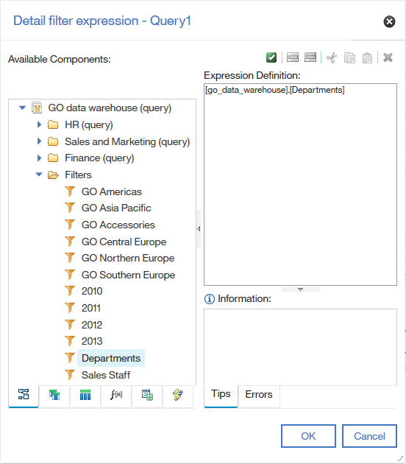
Apply Pre-defined Filters
Published with the package
Advantages:
Reuse
Encapsulation

Slide 47
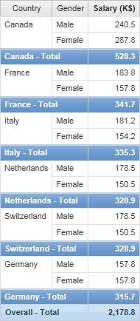
Homework #1 – Sorting & Formatting
List countries, genders, and salaries for countries that exceeded 300,000$ in salaries of 2012
Sort countries by Salary DESC, and their details by Gender DESC
Show salary as number, in thousands, with one decimal place
What is the Detail aggregate of Salary?
Hints
Package: GO data warehouse (query)
Namespace: HR (query) > Employee Summary (query)
Notes:
On course B6058, units 1-3

Slide 48
4 Create Crosstab Reports
TOC

Slide 49
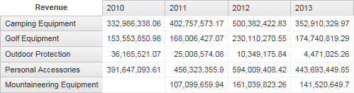
Crosstab Reports
Add query items to edges, add measures to the body (intersection) or edges
Measure: anything that can be aggregated: revenue, quantity, profit margin
Usage: Analyzing and comparing summarized numeric data in rows and columns
You can add a default measure to be used when no measure is defined on the row or column edge
Crosstabs are, by design, dimensional reporting objects
Use drop zones to add parents, peers, and children
Edges
Default Measure
Intersection (Fact Cells)

Slide 50
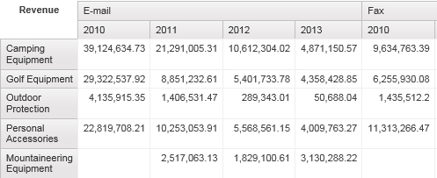
Demo 1: From a List to a Crosstab
Pivot List to Crosstab
Swap Rows and Columns
Notes:
Page 129 in B5A58_V1_INST_STUD.pdf

Slide 51
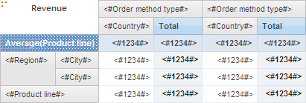
Crosstab Nodes
A crosstab node contains one or more crosstab node members
This crosstab node contains two crosstab node members: Region and City.
Notes:
Crosstab nodes (in columns/rows): are distinct edges that you face when coming from outside the crosstab.
Crosstab node members: are data items that are inside a crosstab node.
Example: in the columns of the above crosstab, we have:
One crosstab node: the Order method type and its children. Nested under it, we have:
Three crosstab node members (data items): [Order method type], [Country], and [Total]

Slide 52
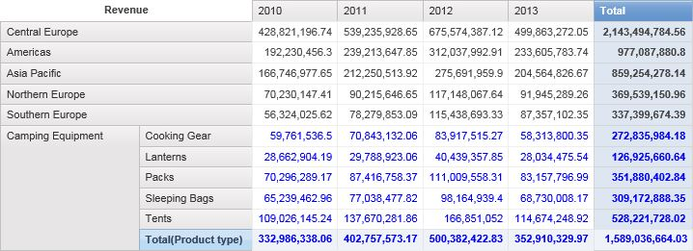
Exercise 3: Discontinuous crosstabs
Adding unrelated data
Sorting & formatting
Notes:
Page 145 in B5A58_V1_INST_STUD.pdf

Slide 53
5 Present Data Graphically A picture is worth a thousand words
TOC

Slide 54
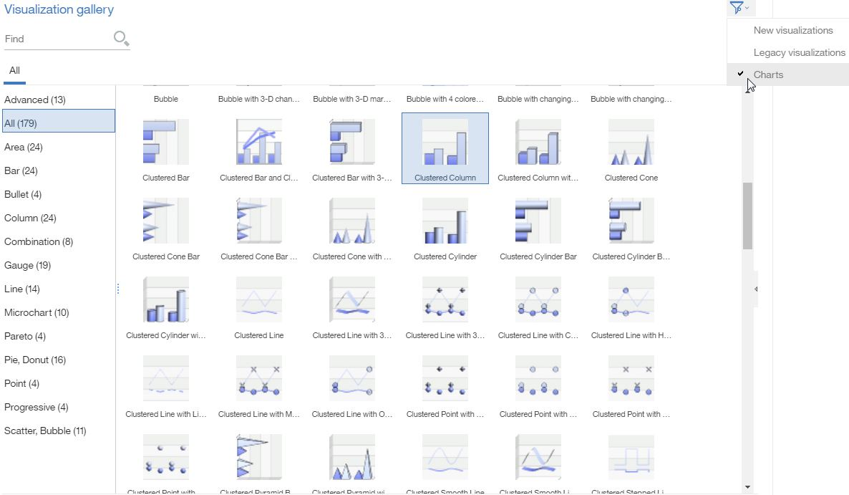
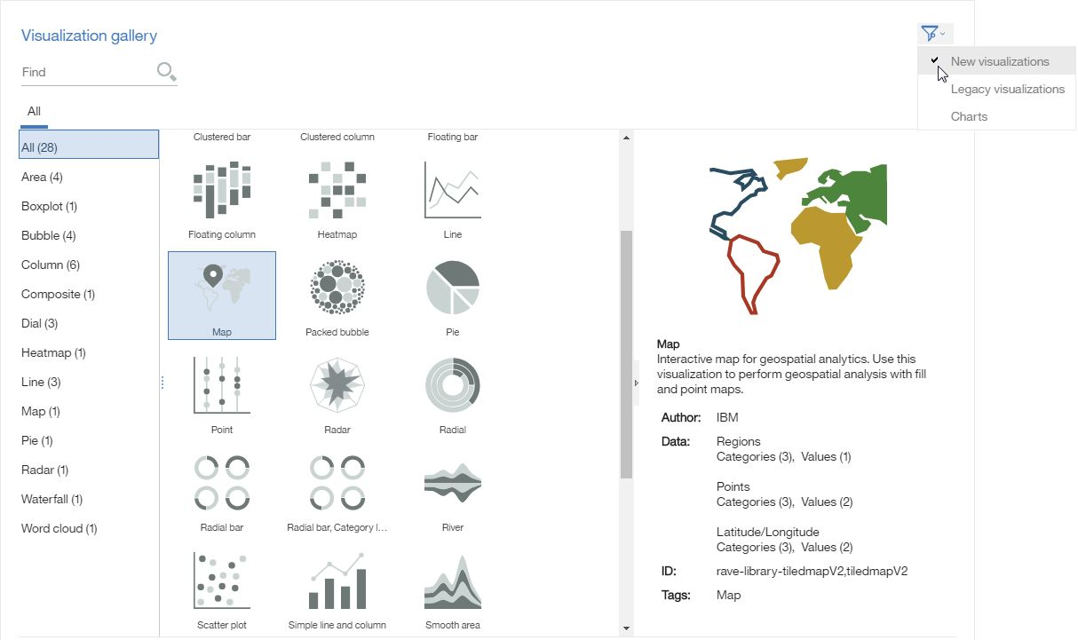
Different Chart Options
Charts and Visualizations
Charts
Visualizations (RAVE)

Slide 55
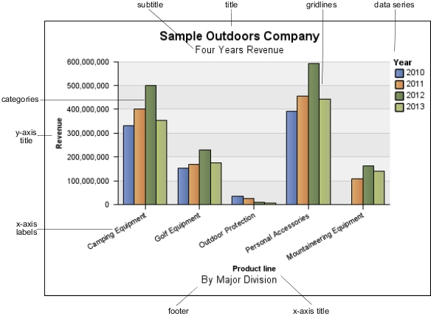
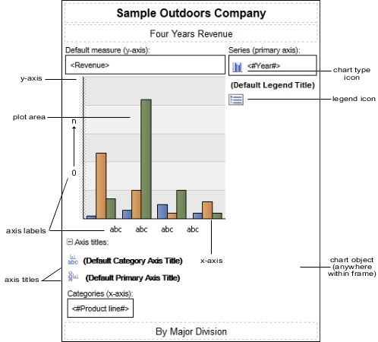
Common Chart Objects
Notes:
Source: IBM Cognos Analytics 11.0 > Analytics on Premises > Reporting > Charts > Creating Charts > Chart Objects
https://www.ibm.com/support/knowledgecenter/SSEP7J_11.0.0/com.ibm.swg.ba.cognos.ug_cr_rptstd.doc/c_chart_parts.html

Slide 56
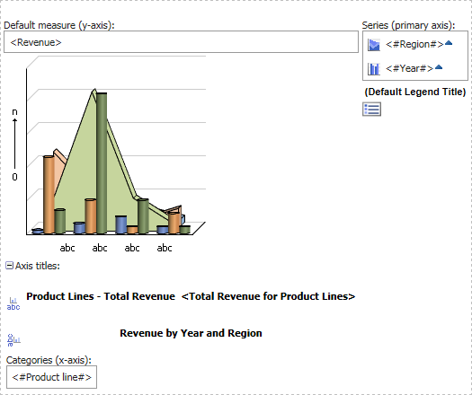
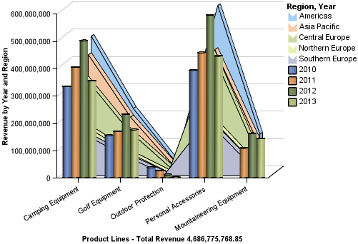
Demo 1: Clustered Bar and Stacked Area
Query Calculation Total([Revenue])
Notes:
Page 173 in B6058_Course_Guide.pdf

Slide 57
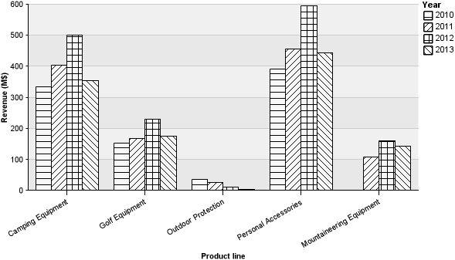
Palettes
A palette defines
Borders
Background, Foreground
Fill type: Color, Gradient, Image, or Pattern (useful for printing in black & white)

Slide 58
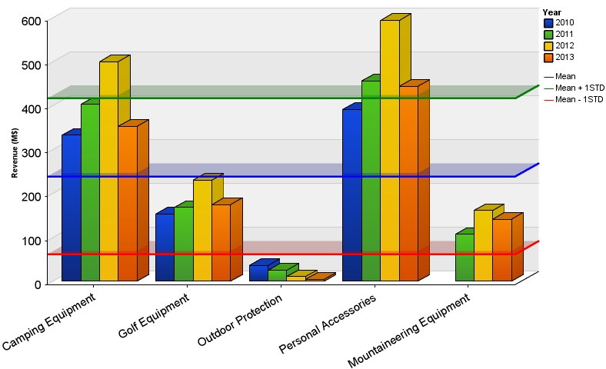
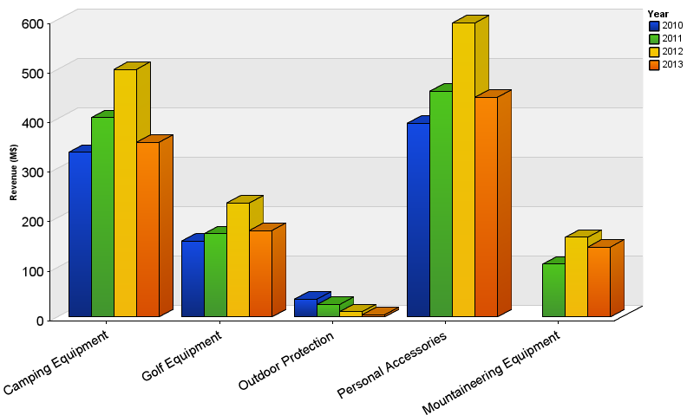
Baselines
“I want to know which product lines exceeded the average revenue”
Baselines help business users to quickly identify targets / thresholds
Can be:
Constant (300M, …etc.)
Data-driven (Mean, …etc.)

Slide 59
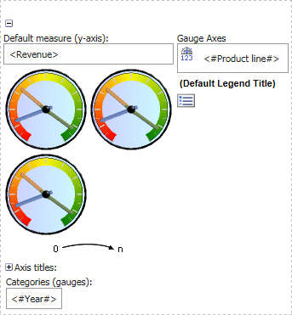
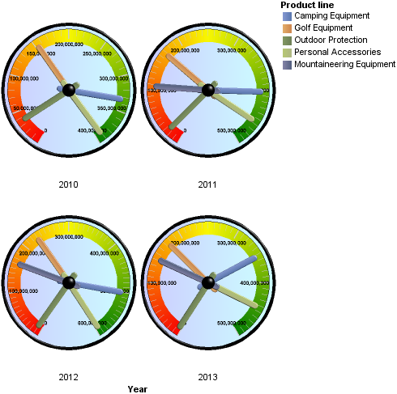
Using Gauge Charts to Compare Values

Slide 60
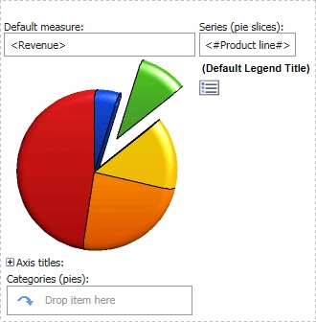
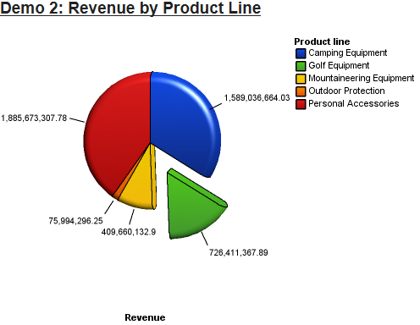
Demo 2: Pie Charts to Compare Proportions
Notes:
Page 188 in B6058_Course_Guide.pdf

Slide 61
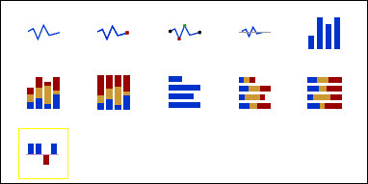
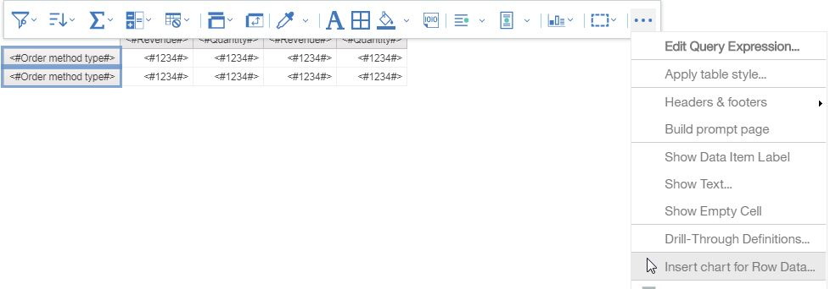
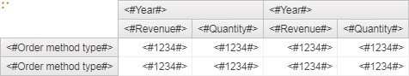
Microcharts
Smaller versions of column, bar, and line charts
Can be used in Lists, Crosstabs and Dashboards.
Notes:
We will learn another way of adding charts to lists/crosstabs in B6059 Unit 2 (page 85)

Slide 62
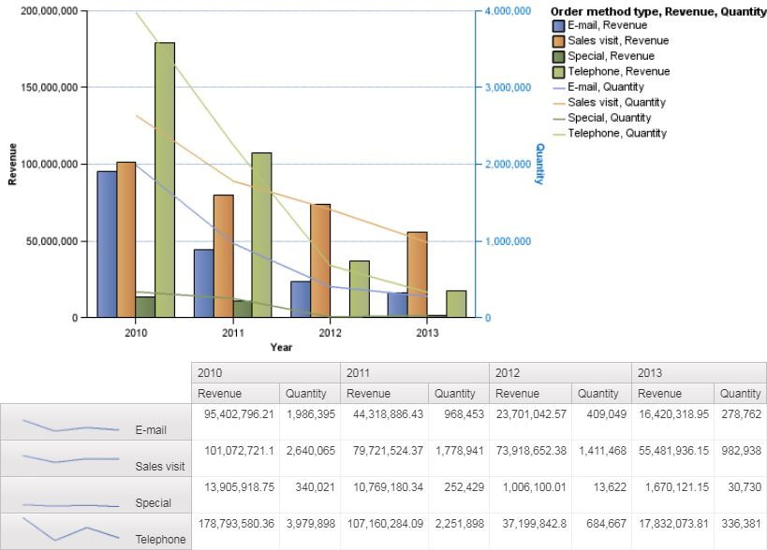
Exercise 3: Same data graphically & numerically
Notes:
Page 184 in B6058_Course_Guide.pdf

Slide 63

Customize Charts
Color schemes
Axis scale
Fill & Background
Tooltips
Notes (hide whatever is under them)

Slide 64

RAVE: Rapidly Adaptive Visualization Engine
Uses JSON syntax to describe the visualization
Flexible and extensible
Interacts with animations

Slide 65

Demo 4: Display Visualizations
Add a Visualization > Bubble > Packed bubble
Notes:
TODO: Add a better RAVE demo with animation

Slide 66
See Also
Choosing a Chart Type and Configuration
Cognos Business Intelligence & Cognos Analytics All Visualizations Deployment

Slide 67

Use of Types of Reports
Product Line | Year | Revenue
Camping Equipment | 2006 | $500,382,422.83
Camping Equipment | 2007 | $352,910,329.97
Golf Equipment | 2006 | $174,740,819.29
Golf Equipment | 2007 | $230,110,270.55
List
Present tabular information
Show detailed information from the DB
Repeater Table
Repeating a layout horizontally & vertically
Crosstab
Analyzing and comparing summarized numeric data in rows and columns
Chart
Present data graphically
Comparisons, relationships, trends
Revenue | 2006 | 2007
Camping Equipment | $500,382,422.83 | $352,910,329.97
Golf Equipment | $230,110,270.55 | $174,740,819.29
Notes:
This is a review slide on different report types learnt so far and the use of each of them

Slide 68
6 Focus Reports Using Prompts
TOC

Slide 69



Prompts and Parameters
Prompts ask the user to provide the value for a parameter that will be used in the report (probably in a filter)
Ways of creating prompts:
Use an unassigned filter (will generate an appropriate prompt based on the model)
Create a prompt page by selecting columns & clicking the Build Prompt Page button
Use a prompt item (in a prompt page or a report page)
Prompt types
Localizable properties: Header Text, …etc
Adding Report/Prompt Pages to a report
Creating a cascading prompt
Exercise 4: page 231
Add Static Choices to a prompt

Slide 70
7 Extend Reports Using Calculations
TOC

Slide 71


Calculations
Query Calculation
Layout Calculation
Create calculations based on data from the data source
Add run-time information to the report

Slide 72
Some Common Functions – Numeric
Function | Description
cast ( expression, datatype) | Converts expression to the specified datatype
ceil ( numeric_expression ) | Returns the smallest integer ≥ numeric_expression
floor ( numeric_expression ) | Returns the largest integer ≤ numeric_expression
mod ( integer_expression1, integer_expression2 ) | Returns the remainder (modulus) of integer_expression1 / integer_expression2
Notes:
Reference:
Common Functions
https://www.ibm.com/support/knowledgecenter/SSEP7J_11.0.0/com.ibm.swg.ba.cognos.ca_mdlg.doc/c_sql-99.html

Slide 73
Some Common Functions – Date/Time
Function | Description
current_date | Returns the current date of the database engine
current_time | Returns the current time of the database engine if it supports this function. Otherwise, the current time of the Cognos Analytics server
extract ( datepart , datetime_expression ) | Returns an integer representing the value of datepart (year, month, day, hour, minute, second) in datetime_expression
_first_of_month (date_expression) | Returns date_expression with the day set to 1
localtime | Returns current time of the database engine
Notes:
Reference:
Business Date/Time Functions
https://www.ibm.com/support/knowledgecenter/SSEP7J_11.0.0/com.ibm.swg.ba.cognos.ca_mdlg.doc/c_businesstimefunction.html

Slide 74
Some Common Functions – Text
Function | Description
char_length (string_expression) | Returns number of logical characters in string_expression
position ( keyword, text ) | Returns the integer position of keyword in text, or 0 if not found
substring ( text, start_position, num_of_chars ) | Returns the substring of text that starts at start_position for num_of_chars characters. First position in text is 1
trim ( [ [leading | trailing | both] [chars_to_remove] , ] text ) | Returns text trimmed of leading or trailing blanks or trimmed of a certain character specified in "chars_to_remove". "Both" is the default for first argument. " " is the default for second argument
upper ( string_expression ) | Returns string_expression in uppercase
Notes:
Reference:
Common Functions
https://www.ibm.com/support/knowledgecenter/SSEP7J_11.0.0/com.ibm.swg.ba.cognos.ca_mdlg.doc/c_sql-99.html

Slide 75

Some Common Functions – Summaries
Function | Description
percentage ( data_item ) | Returns the percentage of total for data_item
total ( data_item ) | Returns the total value for data_item
running-count ( data_item ) | Returns the running count by row, for data_item
Notes:
Reference:
Summaries
https://www.ibm.com/support/knowledgecenter/SSEP7J_11.0.0/com.ibm.swg.ba.cognos.ca_mdlg.doc/c_summaries.html

Slide 76
Common Functions – Report Functions
Function | Description
AsOfDate() | The report execution date
PageCount() | Returns number of pages. For PDF, Excel or saved output
PageName() | Returns the current page name
PageNumber() | Returns the current page number
ParamDisplayValue ('parameterName') | Returns a string that is the parameter display value of "parameterName"
ReportOutput() | Returns the name of the output format, such as CSV, HTML, MHT, PDF, spreadsheetML (Excel 2007 format), XHTML, XML, …etc
Notes:
Reference:
Report Functions
https://www.ibm.com/support/knowledgecenter/SSEP7J_10.2.2/com.ibm.swg.ba.cognos.ug_cr_rptstd.10.2.2.doc/c_cogrsreportfunctions.html

Slide 77
QoS Indicators
Data modeler can set a quality of service (QoS) indicator (icon beside the function) to indicate behavior of functions
Report authors use QoS indicators to determine which function to use
Symbol | Indicator | Meaning
X | Not available | Not available for any data source in the package
!! | Limited availability | The function is not available for some data sources in the package
! | Poor performance | The function is available for all data sources in the package but may have poor performance in some data sources
(no symbol) | Unconstraint | The function is available for all data sources

Slide 78


Query Calculations and Layout Calculations
Demo 1 Add calculations to a report
Exercise 2 Display Prompt Selections in the Title
Notes:
Demo 1 is on page 267 of B6058_Course_Guide.pdf
Exercise 2 is on page 273 of B6058_Course_Guide.pdf
TODO: Talk about predefined calculations

Slide 79
8 Use Additional Report Building Techniques
TOC

Slide 80

Enhance report design with report objects
Set properties at highest level (property inheritance)
Avoid fixed-size objects
Use headers and footers to repeat on each page
Use Padding, Margin, and Blocks for spacing
Use a Table to organize objects
Sections (vs. headers)
Box Model

Slide 81


Reuse Objects/Layout
Layout Component Reference
Overrides
Embed: Reference / Copy
Report templates
Convert report to template
Notes:
The Embed property of the Layout Component Reference object is set to Reference by default.

Slide 82


Handle Reports with No Data Available
Hide the whole page if all data containers are empty
Render Page when Empty: Yes / No
Replace empty data container
No Data Contents
Don’t display
Specified text
Content specified in the No data tab
Exercise 3: page 314
Notes:
Page 314 of B6058_Course_Guide.pdf

Slide 83
Homework #2 – Inventory Alert
List products that have closing inventory values ≤ a number that is specified by the user in a text box on a previous page.
If no products are found, then list bottom 10 products in closing inventory.
Sort by closing inventory ascending
Global filter: Year: 2013
Hints
Package: GO data warehouse (query)
Namespace: Sales and Marketing (query) > Inventory (query)
Testcases
Closing inventory | # of Products
10000 | 4
1000 | Bottom 10
Notes:
On course B6058, modules 4-8

Slide 84




Homework #2 – Required Output
Notes:
On course B6058, modules 4-8

Slide 85
9 Customize Reports with Conditional Formatting
TOC
Notes:
Students should do Exercise 1, on page 360 of B6058_Course_Guide.pdf

Slide 86
10 Drill-Through Definitions
TOC

Slide 87
Navigate to Related Data in Cognos
Let user navigate to reports to see related information
Can setup drill-through access to and from reports using dimensional and relational data sources
Can also setup drill through access
from third party sources to Cognos, and
from Cognos to third party targets
By URL requests or by using the SDK
You must map values that the source will pass to the target

Slide 88

Package-based Drill Through
From relational/dimensional sources
Sources using the GO Data Warehouse (analysis) package
Cognos Analytics reports
Event Studio agent
3rd party using URL
3rd party using SDK
Using a drill-through definition created for the same package
Target Report
To targets created from relational/dimensional sources

Slide 89
Package-based drill-through definition steps
1. Create the target report.
2. Create the drill-through definition.
3. Drill through to the target report.
Create the target report*
Select the package
Create a report, using the source package
Limit the data items from which users can drill through*
Add a parameter to the target report*
Drill through to view related data in the target report
Save the target report
Select the target report
The target report appears and displays filtered data
Hide the target report*
Map the parameter values passed to the target report if needed, or specify dynamic filtering of target*
* Optional
Notes:
You must enable the drill behavior in the source report

Slide 90

Drill Through Assistant
The Drill Through Assistant lets you see the values that are passed from the source report to the target report.
It needs to be granted by the administrator
Values
Source
Target
Drill Through Assistant

Slide 91
Demo 1: Set up drill-through for a package
Let users navigate to detailed product line sales from reports using the package GO Data Warehouse (query)
Target report to display data for the Product Line from which users drill through
Team content > Samples_LG > Models > GO Data Warehouse (query) > Report Studio Report Samples > Total Revenue by Country
Do NOT use Chrome here!
Use Drill Through Assistant to view values that are passed
Notes:
I could not set the scope in Chrome. TODO: Report the issue

Slide 92



Dynamic drill-through - matching criteria
Matches source model item names to:
target model data item name
target report data item name
If no match: source item is ignored
Data item name in the package
Data item name in the report

Slide 93
Homework #3 – Employee Expenses Dashboard
Design a dashboard that includes (on the same page):
3D Pie Chart with Rounded Bevel: Branch region, Expenses (M$)
Crosstab: Branch region, Gender, Month, Expenses (K$)
Sort regions by total expense DESC, and months ASC
Global filter: Year = 2013
Interaction:
Clicking a region on the pie or the legend filters the crosstab by the region, and explodes that region in the pie chart
Clicking Reset Filters in the crosstab corner resets filters
Hints
Package: GO Data Warehouse (query)
Namespace: HR (query) > Employee expense (query)
Notes:
On course B5A58, modules 4-10

Slide 94


Homework #3 – Required Output
Notes:
On course B5A58, modules 4-10

Slide 95
11 Enhance Report Layout
TOC

Slide 96

Objectives
View the structure of the report
Force page breaks in reports
Horizontal Pagination
Modify Structures – Lock / Unlock
Change PDF Page Orientation
Override the page setup for this page
Set PDF Security Options
Format Objects Across Reports - CSS
Notes:
Default styles are stored in a style sheet named GlobalReportStyles.css

Slide 97

Force Page Breaks in Reports
Add a Page set
Associate it to the Query
Set Grouping and sorting
Drag the page under Detail Pages of the Page set

Slide 98

Horizontal Pagination
PDF, List and Crosstabs only
Add horizontal page numbers
Preset (using Number Style)
Custom Number Style
Report Layout Functions
Demo:
Freeze columns
Page Number: Custom number style
PageNumber()
Notes:
Use the “1 column” template for the demo

Slide 99
Securing a PDF Report Output
Require a password to open the PDF output
Run with Options > Advanced Options
Run in the Background
Format: PDF, set options:
Check “Requires a password to open the report”
To prevent copying from PDF output:
Run with Options > Advanced Options
Run in the Background
Format: PDF, set options:
Check “Requires a password to access options”
Uncheck “Copy of text, images, and other content”

Slide 100


Format Objects Across Reports - Classes
Format objects quickly and consistently using CSS (Cascading Style Sheets) classes
Classes property
can apply multiple classes
(Don’t Print): hides the object in PDF

Slide 101

Homework #4 – Highlighting Search Results
Product marketing team want to ensure that the proper messages are reaching the customers
Notes:
Reference:
IBM Cognos 10 Report Studio: Practical Examples, page 21
http://www.ibmpressbooks.com/store/ibm-cognos-10-report-studio-practical-examples-9780132656757
http://www.books24x7.com/assetviewer.aspx?bookid=44236&chunkid=711475766

Slide 102
IBM Cognos Analytics Author Reports Advanced (v11.0)
B6059

Slide 103
Table of Contents – B6059
Create Query Models
Create Reports Based on Query Relationships
Create Advanced Dynamic Reports
Design Effective Prompts
Create Additional Advanced Reports
Examine the Report Specification
Distribute Reports Through Bursting
Enhance User Interaction with HTML

Slide 104
1 Create Query Models

Slide 105
Objectives
Build query models and then connect them to the report layout
Add calculated items to queries
View Tabular Data of a query
Create/modify queries using SQL
Add filters and prompts to a report using the query model
e.g. filtering a query based on data from another query
Notes:
Using Data Item from the toolbox

Slide 106

Demos
Build a Query and Connect it to a report:
Product line, Product type, Revenue, Projected Revenue (1.07 * Revenue)
Create a report using an SQL statement
Show Generated SQL/MDX
Save to a text file
Create a query using SQL statement (and specify the data source)
Rename query items and remove “For Fetch Only”
Filter query data against data in a separate query
Query1: get products generating revenue ≥ 150,000,000
Query2: get quantity sold from those products, by country

Slide 107
2 Create Reports Based on Query Relationships

Slide 108

Demo 1: Set Operations
List sales representatives then order methods that did not achieve their yearly targets in 2012
Yearly target for a sales rep: 2M
Yearly target for an order method: 24M
Notes:
Students should participate in this demo on the stage.
TODO: Screenshot needs to be updated

Slide 109
Create reports by joining queries
Manager
ManagerID | ManagerName
1 | Ahmed
2 | Ali
3 | Omar
To answer a business question
For relational & dimensional models
Inner & Outer joins
Department
DepartmentID | DepartmentName | ManagerID
1 | Computer Science
2 | Information Systems | 3
Inner Join
DepartmentID | DepartmentName | ManagerID | ManagerName
2 | Information Systems | 3 | Omar
Outer Join
DepartmentID | DepartmentName | ManagerID | ManagerName
1 | Computer Science
2 | Information Systems | 3 | Omar
 |  | 1 | Ahmed
 |  | 2 | Ali

Slide 110

Demo 1: Query Relationships
List products that are sold with a specific product (selected by the user)
Example: Sun Shield

Slide 111

From yesterday
Default prompts when using Build Prompt Page
Prompt’s Required property
Update Layout Component Reference manually
Demo on Master-Detail Relationships

Slide 112

Create a report within a report
Use Master-detail relationships to create relationships between nested data containers
Product line
Revenue
Product line Sales Trends
Camping Equipment
$4,578,321
Mountaineering Equipment
$4,343,692
Personal Accessories
$3,178,613
Master list
Detail chart inside a list
Notes:
TODO: Make in a table

Slide 113
3 Create Advanced Dynamic Reports

Slide 114
Query Macros & Session Parameters
Query macro: an expression that is embedded directly in the SQL of a query to alter the SQL at runtime
prompt
sq
Better to be placed into the Framework Manager model, but you not have access to the project
Session parameters: exposed by the authentication source (NTLM, LDAP, ..etc)
$account.defaultName
$runLocale

Slide 115

1: Filter report on session parameter values
Session parameters are made available by authentication source (e.g. LDAP) Example: account.defaultName
Filter: [Employee name]=# sq ($account.defaultName) # (to see the filter: show [Employee name] column)
Set Page’s query to Query 1
Add a Layout Calculation after report header: [Query1].[Employee name]
Pick up style of header & apply style to the Layout Calculation
Run with user: smythed

Slide 116




2: Navigate Reports with Links
Navigate reports using a Table Of Contents (TOC)
Quickly navigate to: grouped items, sectioned items, or multiple pages
TOC entries are static or data-driven
Only for PDF or saved HTML output

Slide 117

2: Navigate Reports with Links
Tabbed reports in HTML & Excel (report properties)
Add custom links for better navigation (e.g. Top link)
Notes:
Authoring tabbed reports using lists and crosstab styles
https://youtu.be/yOaEsRnGvQg

Slide 118

3: Create Dynamic Data Items and Titles
Use calculated data items to:
create dynamic column titles and report titles
display user prompt selections
Demo
Dynamic titles set by a prompt
Dynamic calculation

Slide 119

4: Navigate to details in the same report
You can create a report that drills through to itself to let users select an item from a high-level list and view its details in a separate list.

Slide 120
4 Design Effective Prompts

Slide 121
2: Create a Prompt to Allow Selection Between Filters
Filter:
# prompt ('Chosen Filter', 'token', '[Date] between 2012-01-01 00:00:00 and 2012-12-31 23:59:59') #
Value Prompt
Static Values
Date Prompt
Parameter: date_range
Use | Display
[Date] between 2012-01-01 00:00:00 and 2012-12-31 23:59:59 | All orders in 2012
Cast([Date],date)=2012-09-30 | Last day 3rd quarter
[Date] in_range ?date_range? | Date range
Notes:
Documentation about the prompt function:
http://www-01.ibm.com/support/knowledgecenter/SSEP7J_10.2.2/com.ibm.swg.ba.cognos.ug_cr_rptstd.10.2.2.doc/c_cr_rptstd_wrkdat_creating_prompts_using_query_macros.html

Slide 122
5 Create Additional Advanced Reports
Notes:
I did not see any questions come from this module in the exam.
This presentation is enough for the module + demo 4 on page 242

Slide 123


Create Additional Advanced Reports
Display summaries before details
Display Single Data Value
Split table cells (in a list header)
Move summaries from footer to header
Use Singleton to display summarized information

Slide 124


Highlight Alternate Rows
List Columns Body Style
running-count([Employee name])
mod(running-count([Employee name]),2)

Slide 125
Use External Data
When required data is not in the package, nor in any data source
Examples:
Currency exchange Web service that sends Excel data sheets on daily basis
External legacy system that produces CSV files on monthly basis
Solution:
Extend existing packages with new query subjects (Manage External Data)
Remember: A report can refer to one package only at a time

Slide 126
6 Examine Report Specification

Slide 127
Objectives
Report specification structure
Header (model, language, namespace)
Queries
Layouts (prompt pages, report pages, styles)
Report variables
Modify a report specification
Cognos Analytics Reporting validates syntax & semantics, but text editors don’t
Report specification flow
Create custom toolbox and template objects

Slide 128

Report Specification Flow
Save and Open Reports
Run Reports
Cognos Analytics
Reporting
Cognos Analytics portal
IBM Cognos Viewer
Report Spec
Request for report spec
Report Spec and Data
Content Manager
Content Manager
Report Spec
Report Service
Report Spec
Report Spec
Data
Request
Queries
Content store
Data source
Content store
Data source
Notes:
The illustrated Run cycle is when the user runs a report from the portal

Slide 129


Toolbox Controls and Templates
Toolbox control:
Add code to: ToolboxControls.xml
Add reference to it in: Toolbox.xml
Template:
Add code to: templates.xml
Add reference to it in: Resources.xml

Slide 130
7 Distribute Reports Through Bursting

Slide 131
Steps of Bursting Reports
Prepare burst recipients in Cognos Analytics Reporting
Set burst options in Cognos Analytics Reporting
Run the report in Cognos Analytics portal with bursting enabled

Slide 132
Step 1: Prepare Burst Recipients
Burst to directories and/or e-mail
E-mails from:
Authentication source / Cognos profile
Data source
A calculated field
Burst table column

Slide 133
Step 2: Set Burst Options in Reporting
Group the report on the data item to burst on (optional)
Burst groups: how to separate data?
Burst recipient: who receives the subset of data?
Burst key: map burst groups to recipients

Slide 134

Step 2: Set Burst Options in Reporting
Notes:
Label specifies how the burst is labelled in Cognos Analytics portal. By default it is the data item being grouped.

Slide 135
Existing users in the mail server
First Name | Last Name | Internet Address
Admin | Person | admin@grtd123.com
Donald | Chow | DChow@grtd123.com
Frank | Bretton | FBretton@grtd123.com
Bart | Scott | BScott@grtd123.com
Dave | Smythe | DSmythe@grtd123.com
John | Sinden | JSinden@grtd123.com
Alessandra | Torta | ATorta@grtd123.com
Branka | Hirsch | BHirsch@grtd123.com

Slide 136
Step 3: Run with bursting enabled
Run as Frank Bretton
Run with Options (advanced options)
Run in the background
Bursting: Burst the report
Delivery: Save & Send by email

Slide 137




Slide 138

Demo 1: Burst to e-mail using data item
Filters: [Employee name] in ('Bart Scott', 'Alessandra Torta', 'John Sinden')
Include Email in Query1 & in Properties of List1
Burst to Email addresses
Notes:
We filter for employees Scott, Sinden, and Torta because we did not create mailboxes for all employees in the database.

Slide 139

Bursting a Dimensional Container
Use burst key with one dimension data container (List)
For multiple dimensions containers (Chart/Crosstab..)
create a master detail relationship between this query and a single dimensional query
add the burst key to the single dimensional query.

Slide 140
Considerations when bursting the CA portal
Burst to Team content
Bursting generates report outputs that are specific to the current user

Slide 141
8 Enhance User Interaction with HTML

Slide 142

Your feedback really matters…

Slide 143
See Also..
IBM Cognos Analytics channel www.youtube.com/user/Analyticszone
Videos: Arabic & English
IBM Analytics User Community https://www.ibm.com/communities/analytics/cognos-analytics
IBM Cognos Analytics Learning Center
IBM Skills Academy – Business Intelligence Analyst community: Resources
IBM Skills Gateway
IBM Analytics Product Skills Validation Open Badge Program
Setting up the IBM Cognos Audit database and sample reports‬‏ - YouTube

Slide 144
B6098 IBM Cognos Analytics – Author Active Reports
TOC

Slide 145
Table of Contents – B6098
Introduction to IBM Cognos Active Reports
Use Active Report connections
Active Report charts visualizations and decks

Slide 146
1 Introduction to IBM Cognos Active Reports
B6098

Slide 147




Why Active Reports?
Interactivity
Performance
Disconnected
Distribution
Cognos Analytics Reporting

Slide 148



What is an Active Report?
A report type whose output is HTML / MHT
Viewable by
Preview (in Reporting)
Report Viewer
Downloadable file
Cognos Mobile

Slide 149



Active Report Controls
Static or data-driven

Slide 150
2 Use Active Report connections
B6098

Slide 151

Interactive Behavior
Three reactions are available through Reaction behavior property:
Select an item in a control
Filter items in a control
Control enable
Notes:
Behavior on select: how the control affects other variables.
Reaction behavior: how is the control affected by other variables.

Slide 152

Demo 1: Using Static and Data Controls

Slide 153

Converting a Report to an Active Report
Save > Convert to Active Report
Unsupported objects will be removed
Prompt controls
Table of contents
Table of contents entries
Bookmarks

Slide 154


Active Report Properties
Window Title
Default + more titles (translations)
Security
A password (access key) can be added to an Active Report on a report-by-report basis

Slide 155




Debugging Active Reports
The debug feature is turned on by default
Located in the Run Options
Debug menu is activated by right-clicking the report

Slide 156



Interactive Behavior Properties
Summarize in Output - show the summarized value for what is displayed in the active report
No Value List Item: default list item (data item = null)
Allow Sorting
Column Visibility

Slide 157
3 Active Report charts visualizations and decks
B6098

Slide 158

Demo 2: Using Data Deck Control

Slide 159
See Also..
IBM Business Analytics Proven Practices: IBM Cognos Active Report Cookbook
B6098: IBM Cognos Analytics - Author Active Reports (v11.0)
101 Tips and Tricks for Active Reports
Samples
Supplementary IBM Cognos Analytics 11 Samples

Slide 160
What’s new in Cognos Analytics?
Changes from Cognos BI 10.2.2 to Cognos Analytics 11.0
What's new in IBM Cognos Analytics
Notes:
This section is intended for those who already know IBM Cognos BI 10.2.2 and want to learn IBM Cognos Analytics.
See also:
Cognos Upgrade Central http://www-01.ibm.com/software/analytics/cognos/customercenter/upgrade.html
How to upgrade your version of Cognos Analytics http://www-01.ibm.com/support/docview.wss?uid=swg21994915

Slide 161

New Features in Cognos Analytics 11
Data sets: cashed data from a data module or package
Themes
New and changed features
Cognos Analytics – New Features by Release
Notes:
Page numbers refer to B6058_Course_Guide.pdf
Themes 26
Overview of the New Enhancements with Cognos Analytics 11.0.7 https://youtu.be/p6-qFaHGOrE

Slide 162
Functionality mapping from Cognos BI to Cognos Analytics
Notes:
Reference: http://www.ibm.com/support/knowledgecenter/SSEP7J_11.0.0/com.ibm.swg.ba.cognos.wig_cr.11.0.0.doc/c_gtstd_map_functionality.html

Slide 163



Creating new reports
Cognos BI
Cognos Analytics
File > New
OR: Toolbar: New
Side panel > New > Report
Notes:
TODO: Investigate “Can be edited in the viewer” in the Filters dialog

Slide 164


Inserting data items from Source tab
Cognos BI
Cognos Analytics
Source tab
Side panel > Data > Source

Slide 165


Page, Query, and Condition Explorer
Cognos BI
Cognos Analytics
Source pane
Source, and Data Items tabs
Toolbox
Explorer Bar
Page Explorer
Query Explorer
Conditional Explorer
Data
Source & Data Items
Toolbox
Pages
Queries
Query explorer
Condition explorer
Notes:
Screenshots from Cognos Analytics 11.0.6

Slide 166


Creating filters
Cognos BI
Cognos Analytics
Click anywhere in the data container
Toolbar: Filters > Edit Filters
Select container > Filters > Edit Filters…
Notes:
TODO: Investigate “Can be edited in the viewer” in the Filters dialog

Slide 167


Aggregation properties
Cognos BI
Cognos Analytics
Aggregate Function
Rollup Aggregate Function
Detail aggregation
Summary aggregation

Slide 168



Switching page views
Cognos BI
Cognos Analytics
Explorer Bar or View menu
Page design
Page structure
Application bar > Page views
Page design
Page preview
Page structure

Slide 169




Allow drill-up & drill-down for dimensional reports
Cognos BI
Cognos Analytics
Data > Drill Behavior > Basic > Report output drill capabilities > Allow drill-up and drill-down
Pages > Report
Application bar > Properties
Drill-up and Drill-down

Slide 170


Import/export report specification
Cognos BI
Cognos Analytics
Tools
Copy Report to Clipboard
Open Report from Clipboard
Pages > right-click Report
Copy Report to Clipboard
Open Report from Clipboard
Notes:
Reference:
How to import/export a report specification in IBM Cognos Analytics 11
http://www-01.ibm.com/support/docview.wss?uid=swg21973886

Slide 171

Relationship between report & package
Cognos BI
Cognos Analytics
A report refers to exactly one package
A report can refer to 0 to N packages
Report
Report
Package
Package
0..1
1..1
0..1
0..n

